Slide 1
Be Warmer At Home! Presentation for Highgate Society 21st Century Homes 8th February 2014 Sarah Harrison Eco-refurbishment
Notes:
Greetings
Introduce myself – worked, done my own house, work as consultant advising individuals and organisations both on houses and on working methods
This evening -.
Going to look at how to make houses more energy and water efficient.
½ hour presentation
Plenty of time for questions/ discussion at the end.
if you want something clarified please do interrupt
but Grateful if you could hold questions or contributions to the end

Slide 2
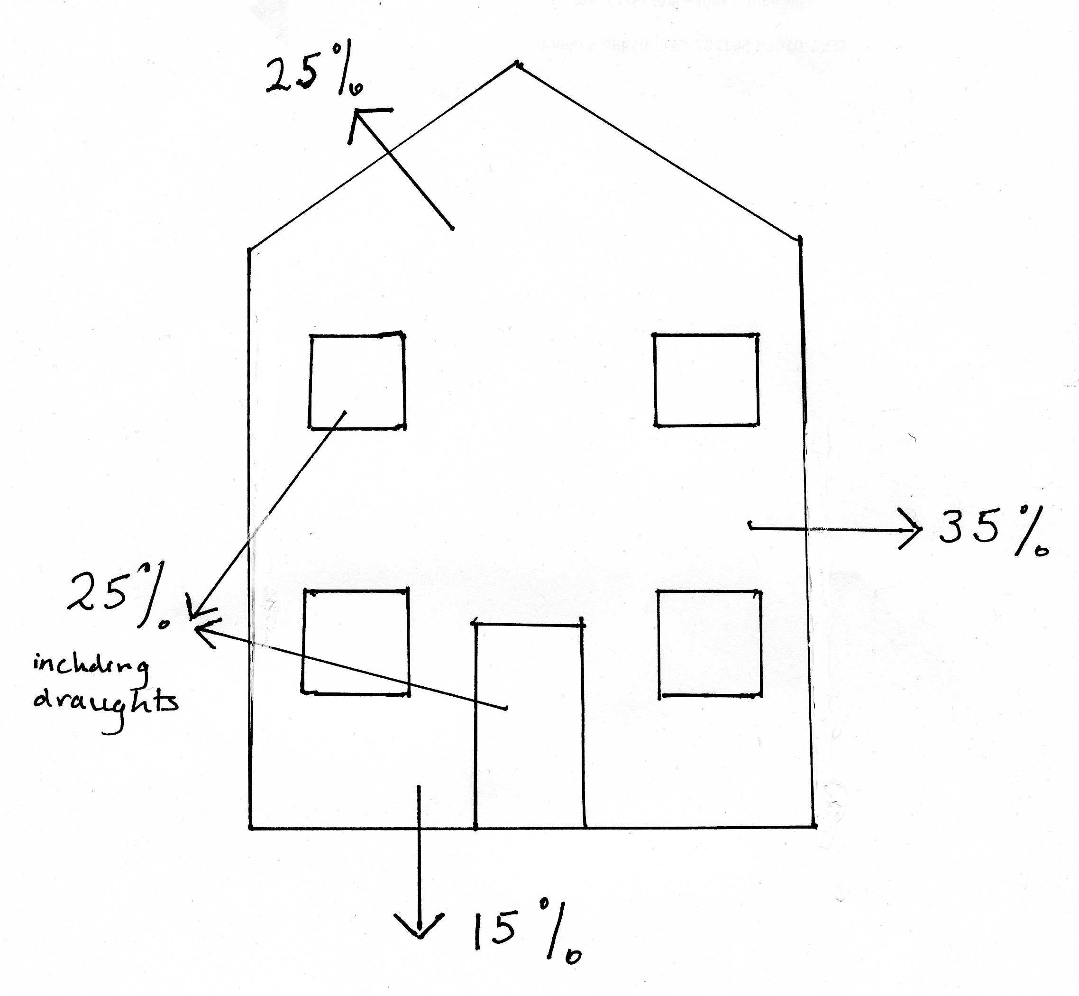
Heat loss from a house
Notes:
Just a quick look to see the relative heat loss from a house.
Clearly averages , vary between buildings and with different conditions.

Slide 3
How to stop this heat loss
Insulation
Wrap the house up to stop the heat escaping
Airtightness
Make sure that there are no unintended gaps or holes in your house.
‘Build tight ! Ventilate right!

Slide 4
What can you do about your roof ?
If you have a loft, insulation can be simple
If you have a flat roof, it be insulated from outside

Slide 5
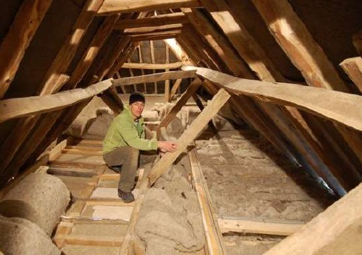
Insulate your loft internally
The insulation is laid on the loft floor
Photo: Black Mountain insulation

Slide 6
Insulate your flat roof externally
The insulation is laid on top of the waterproof membrane

Slide 7
What can you do about your windows?
Improve the glass
Stop the draughts

Slide 8
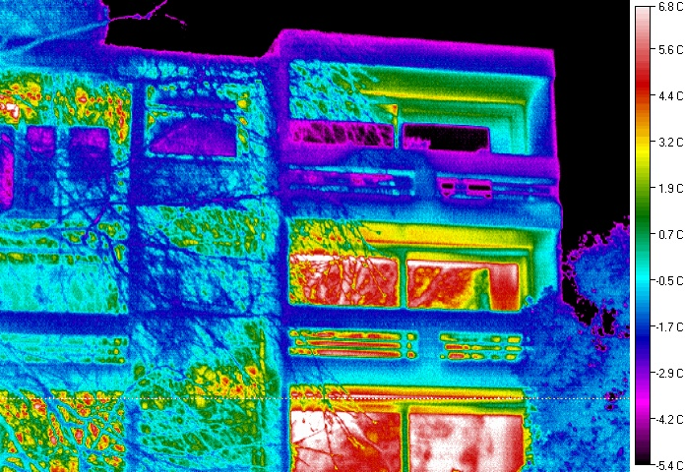
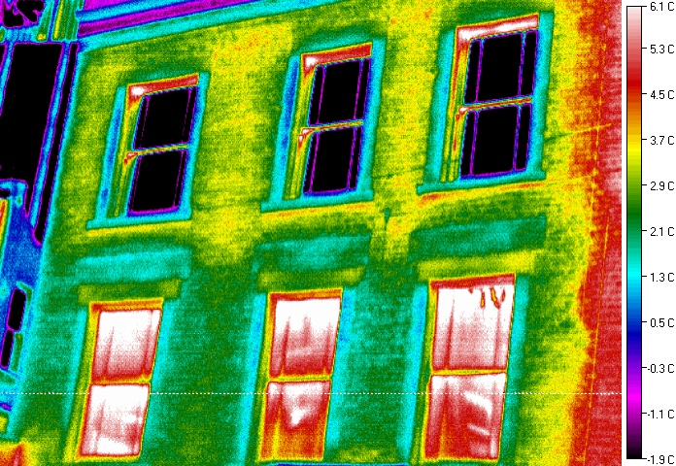
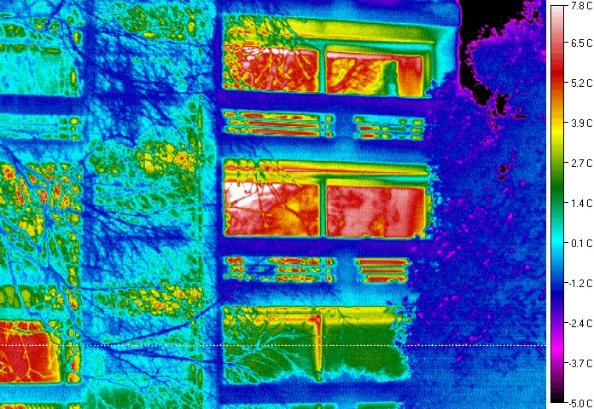
Heat loss from windows
Draught proofed, with thick curtains
Single glazed
Double glazed
Double glazed

Slide 9
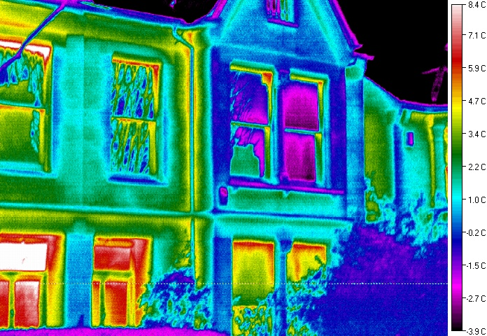
Glass above Front Doors
single glazed glass
secondary glazed glass
Notes:
Questions re glass above front doors:
• Who was happy that the glass above their door was performing well?
• And why was that?
• Suggestions for improvements

Slide 10
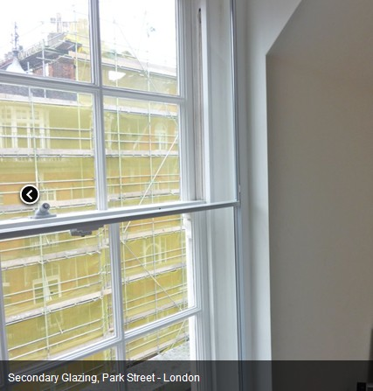
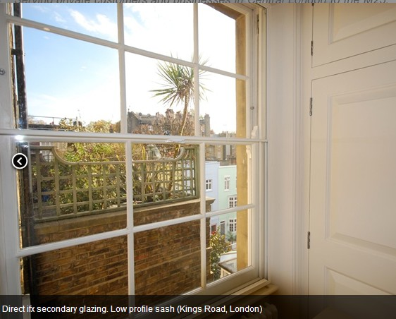
Secondary glazing
Photos: City Sound

Slide 11
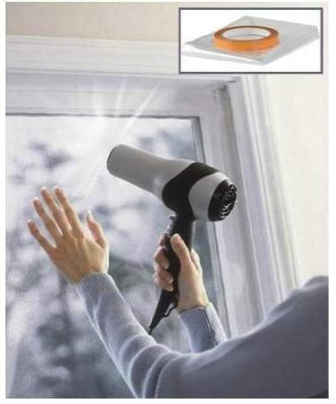
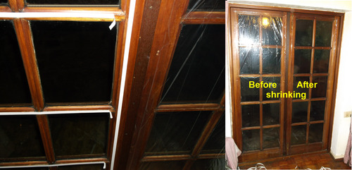
Secondary glazing
The most basic form of secondary glazing is like cling film

Slide 12
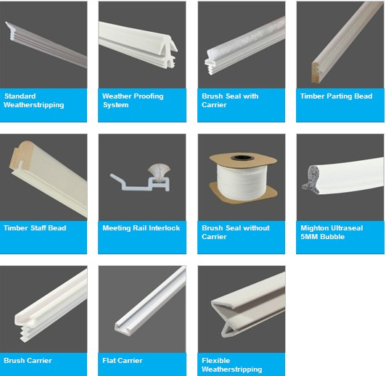
Stopping those draughts
Photo: Mighton

Slide 13
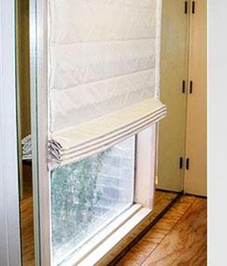

Curtains and blinds
thick, interlined curtains
thermal blinds
thick, interlined door curtains
Photos: Thermal Blind company (left)and Luxaflex

Slide 14
What can you do about your floors ?
When insulation isn’t an option
Use warm surfaces – cork, thick underlay, carpets
Stop draughts – seal floor and skirting boards

Slide 15
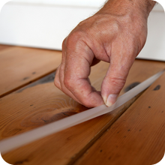
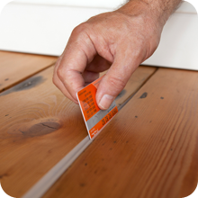
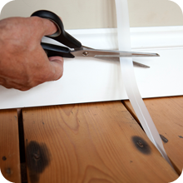
Draughty floors & skirting boards
*StopGap is pushed between floor boards or the skirting board and the floor, cutting out the draughts.
It is practically invisible after fitting.
It can also stop dirt, dust, insects, smells, and noise.
* Good thick carpets with rubber underlay

Slide 16
Airtightness or……
those holes in your house !
Holes the builders left
Unnecessary airbricks
Chimneys
Cat flaps
Letterboxes
Keyholes

Slide 17
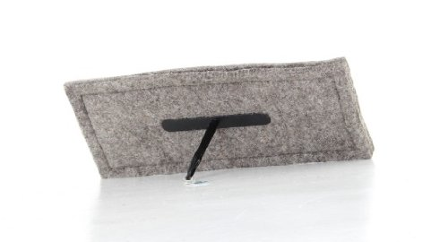
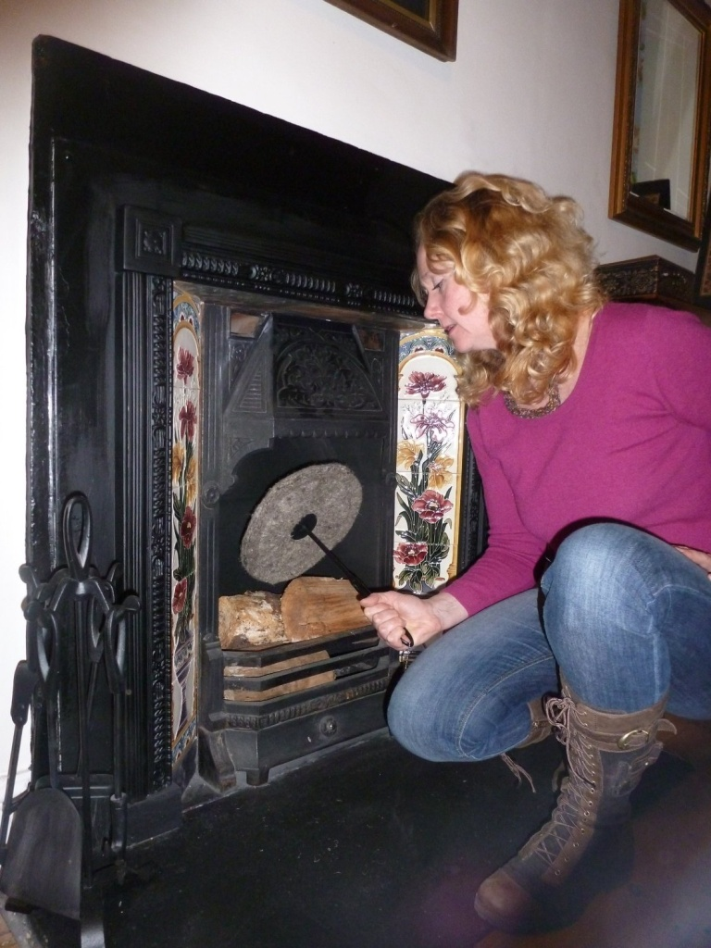
Chimney draught excluder

Slide 18
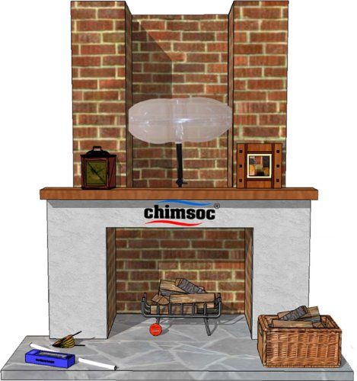
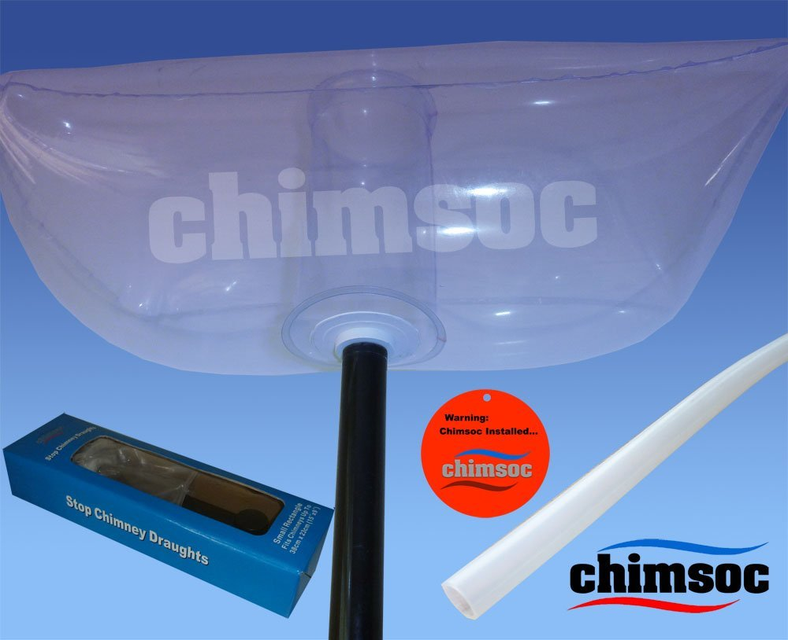
Chimney balloon

Slide 19
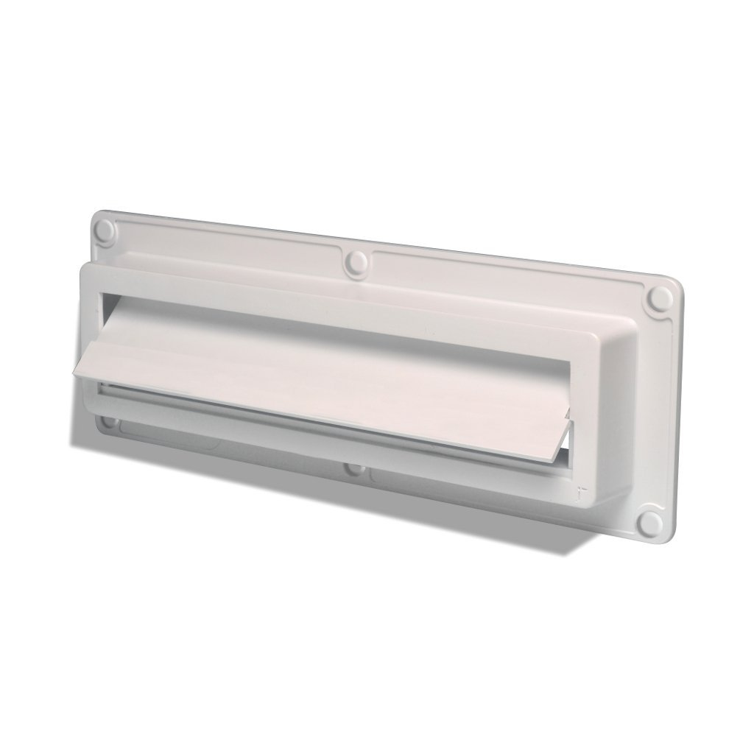
Eco Flap Letterbox
The Ecoflap blows itself shut and not open which ever way the wind is blowing. It also opens easily for a single piece of paper or for a large item

Slide 20
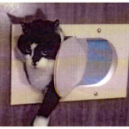
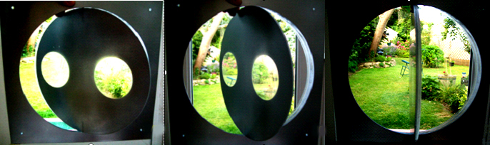
EcoPetway Cat Flap
Draught free and easy for cats to use.
Can be fitted in doors or walls

Slide 21
Ways to make your heating system more efficient
Boilers and controls
Getting the most from your radiators

Slide 22
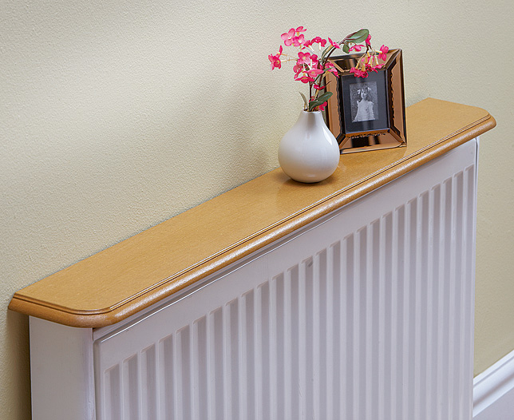
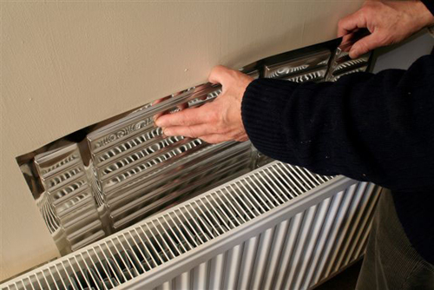
Getting the best from your radiators
Little shelves over the radiator – stop the heat heading straight for the ceiling
Reflective panels – heat the room not the walls

Slide 23
Take advantage of work that you are doing…
There are often opportunities to improve the comfort of the your home when you are undertaking improvements or maintenance. Don’t miss them!

Slide 24
Some simple ways to be warmer at home and create a more comfortable home Sarah Harrison Eco-refurbishment SuperHome Alliance www.eco-refurbishment.co.uk
Notes:
Greetings
Introduce myself – worked, done my own house, work as consultant advising individuals and organisations both on houses and on working methods
This evening -.
Going to look at how to make houses more energy and water efficient.
½ hour presentation
Plenty of time for questions/ discussion at the end.
if you want something clarified please do interrupt
but Grateful if you could hold questions or contributions to the end

